Slide 1
India CPI Inflation

Slide 2

What is CPI Index ?
Consumer Price Index (CPI) measures the average change over time in prices paid by a consumers for a basket of goods and services such as food, housing, transportation, healthcare, education and fuel.
In India the consumer price index is one of the primary indicators used to measure retail inflation and reflects changes in the cost of living for households.
The consumer price index is published by National Statistical Office under the ministry of Statistics and Programme Implementation.
A rise in CPI indicates inflation meaning consumers are paying more for goods and services compared to previous period.

Slide 3
Problem Statement
You are working with the national statical office which is equipped to release inflation numbers in India. As an analyst you are provided with CPI data and are equipped to find out insights from the data. Your senior wants you to find out insights from the data. Your senior wants to find out key trends and deep dive into the data to answer the following questions:
Based on the latest months data identify the contribution of different broader categories (food, energy, transportation education etc.) towards the CPI basket. Broader categories(buckets) can be created combining similar categories into one bucket Ex: Meals, Beverages, Cereals can be clubbed to create “Food” category etc.
Which broader category has the highest contribution towards CPI calculation ?
Contribution is calculated by evaluating underlying index values for broader category and should be 100% when the contribution from different broader categories is added.
2. A trend of Y-O-Y increase in CPI (rural + urban) inflation starting 2017 for the entire basket of products combined.
Create a graph depicting the growth rate Y-O-Y and identify the year with the highest inflation rate.
Highlight the why the year has the highest inflation rate (based on research).

Slide 4
Problem Statement
3. With Indias Retail inflation reaching a 3-month high of 5.55% in November 2023, largely due to sharp rise in food prices analyze the following for 12 months ending May 23.
Investigate trends in prices of broader food bucket category and evaluate month-on-month changes. Highlight month with the highest and lowest food inflation.
Identify the absolute changes in inflation over the same 12 months period and identify the biggest individual category contributor (only within boarder food category) towards inflation.
4. Investigate how onset and progression of covid-19 pandemic affected inflation rates in India. Analyze the impact of key pandemic milestone (first lockdown) on CPI % specifically focus on categories like healthcare, food and essential services.
5. Investigate how major global economic events (like imported crude oil price fluctuations) have influenced Indias inflation. This can include analysis of imported goods and their price trends.
For this purpose, focus only on the imported oil price fluctuations for years 2021-2023 (Month-on-Month).
Identify trends in oil price change with change in inflations prices of all the categories and identify category whose inflation prices strongly changes with fluctuations in imported oil price.

Slide 5
CPI Basket Structure by broader categories
Basic Food Items
Cereals and products
Meat and fish
Egg
Milk and products
Oils and fats
Fruits
Vegetables
Pulses and products
Spices
Other Food and Intoxicants
Sugar and Confectionery
Non-alcoholic beverages
Prepared meals, snacks, sweets, etc.
Food and beverages
Pan, tobacco, and intoxicants

Slide 6
CPI Basket Structure by broader categories
Services and Miscellaneous
Health
Transport and communication
Recreation and amusement
Education
Personal care and effects
Miscellaneous
Clothing and footwear
Clothing
Footwear
Clothing and footwear
Housing and Utilities
Housing
Fuel and light
Household goods and services

Slide 7
CPI Basket Contribution Analysis by Broader Categories
Contribution for inflation in rural sector:
Basic Food Items recorded the highest contribution (36%) towards Rural CPI Inflation among all broader categories followed by Services and Miscellaneous (24%).

Slide 8
CPI Basket Contribution Analysis by Broader Categories
Contribution for inflation in urban sector:
Basic Food Items recorded the highest contribution (36%) towards Urban CPI Inflation among all broader categories followed by Services and Miscellaneous (23%).

Slide 9
CPI Basket Contribution Analysis by Broader Categories
Contribution for inflation in rural + urban sector:
Basic Food Items recorded the highest contribution (35%) towards Rural + Urban CPI Inflation among all broader categories followed by Services and Miscellaneous (23%).

Slide 10
Year – On – Year CPI Inflation Trend Analysis (2017 Onwards)
Y-O-Y Analysis for Rural + Urban Sector:
Highest Inflation
Lowest Inflation
India inflation rise in 2019 was primarily driven by:
Sharp increase in onion and vegetable prices.
Heavy and uneven monsoon damaging agricultural crops.
Food Supply shortages and lower crop production.
Rise in fuel and crude oil prices globally.
Increase in transportation & logistics cost.
Higher food inflation in pulses vegetables and protein rich items.
US China trade war increasing global commodity and price uncertainty.

Slide 11
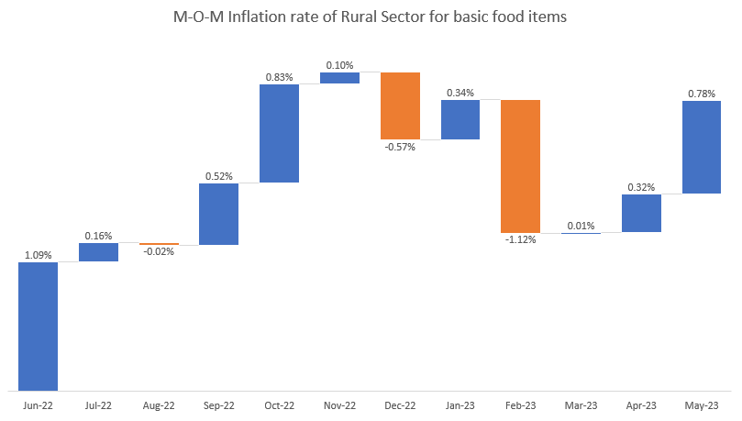
Food Inflation Overview: Rural Sector
Basic Food Items:
Year | May-22 | Jun-22 | Jul-22 | Aug-22 | Sep-22 | Oct-22 | Nov-22 | Dec-22 | Jan-23 | Feb-23 | Mar-23 | Apr-23 | May-23
Basic Food Items | 1584 | 1601 | 1603 | 1603 | 1611 | 1625 | 1626 | 1617 | 1623 | 1604 | 1604 | 1610 | 1622
 | Inflation M-O-M | 1.09% | 0.16% | -0.02% | 0.52% | 0.83% | 0.10% | -0.57% | 0.34% | -1.12% | 0.01% | 0.32% | 0.78%
Rural basic food inflation remained volatile between May 2022 to May 2023 peaking at 1.09% in June 2022 before declining to -1.12% in Feb 2023.
The food inflation recovered to 0.78% in May 2023 after the sharp decline in Feb 2023.
Inflation Rebounded
Highest M-O-M Food Inflation.
Lowest M-O-M Food Inflation

Slide 12
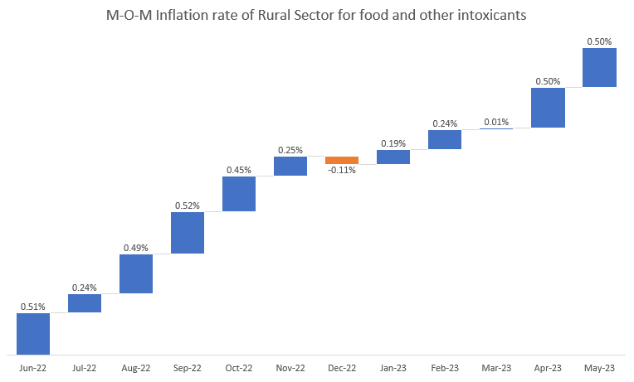
Food Inflation Overview: Rural Sector
Other Food & Intoxicants:
Year | May-22 | Jun-22 | Jul-22 | Aug-22 | Sep-22 | Oct-22 | Nov-22 | Dec-22 | Jan-23 | Feb-23 | Mar-23 | Apr-23 | May-23
Other Food & Intoxicants | 836 | 841 | 843 | 847 | 851 | 855 | 857 | 856 | 858 | 860 | 860 | 864 | 868
 | Inflation M-O-M | 0.51% | 0.24% | 0.49% | 0.52% | 0.45% | 0.25% | -0.11% | 0.19% | 0.24% | 0.01% | 0.50% | 0.50%
Inflation Rebounded
Rural other food and intoxicants inflation remained relatively stable compared to basic food items. The category recorded its highest inflation of 0.52% in Sep 2022 while the lowest inflation of -0.11% was observed in Dec 2022.
After a brief decline inflation gradually recovered and reached 0.50% in May 2023.
Unlike basic food items which exhibited a significant volatility. Other food and intoxicants showed a relatively stable inflation trend throughout the analysis period.
Inflation Rebounded
Highest M-O-M Food Inflation.
Lowest M-O-M Food Inflation

Slide 13
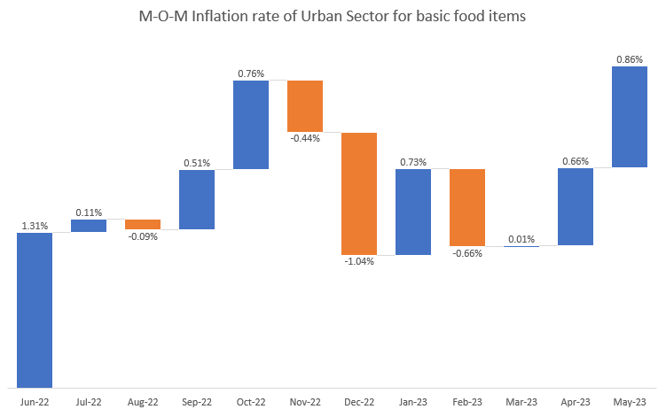
Food Inflation Overview: Urban Sector
Basic Food Items:
Year | May-22 | Jun-22 | Jul-22 | Aug-22 | Sep-22 | Oct-22 | Nov-22 | Dec-22 | Jan-23 | Feb-23 | Mar-23 | Apr-23 | May-23
Basic Food Items | 1620 | 1641 | 1643 | 1642 | 1650 | 1663 | 1655 | 1638 | 1650 | 1639 | 1639 | 1650 | 1664
 | Inflation M-O-M | 1.31% | 0.11% | -0.09% | 0.51% | 0.76% | -0.44% | -1.04% | 0.73% | -0.66% | 0.01% | 0.66% | 0.86%
Urban basic food inflation exhibited a significant volatility between May 2022 and May 2023.
Inflation reached its highest monthly increase of 1.31% in Jun 2022 before falling sharply to -1.04% in Dec 2022.
Following the decline inflation gradually recovered and reached 0.86% in May 2023.
Inflation Rebounded
Highest M-O-M Food Inflation.
Lowest M-O-M Food Inflation

Slide 14
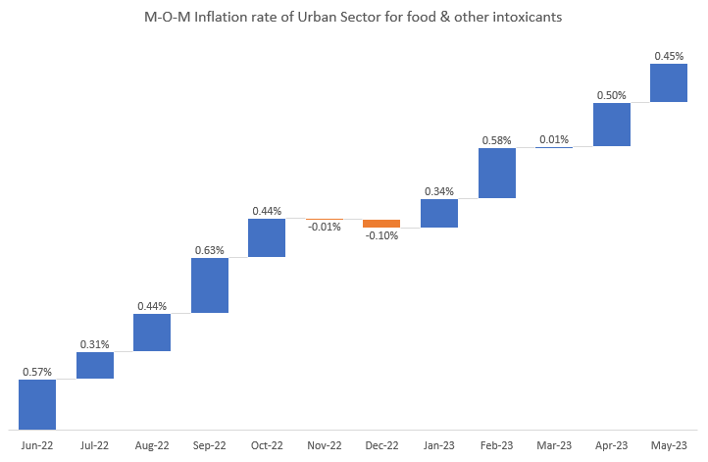
Food Inflation Overview: Urban Sector
Other Food & Intoxicants:
Year | May-22 | Jun-22 | Jul-22 | Aug-22 | Sep-22 | Oct-22 | Nov-22 | Dec-22 | Jan-23 | Feb-23 | Mar-23 | Apr-23 | May-23
Other Food and Intoxicants | 840 | 844 | 847 | 851 | 856 | 860 | 860 | 859 | 862 | 867 | 867 | 871 | 875
 | Inflation M-O-M | 0.57% | 0.31% | 0.44% | 0.63% | 0.44% | -0.01% | -0.10% | 0.34% | 0.58% | 0.01% | 0.50% | 0.45%
Urban other food & intoxicants inflation remained relatively stable throughout the analysis period. The category recorded its highest monthly inflation of 0.63 in Sep 2022 while the lowest inflation of -0.10% was observed in Dec 2022.
After the brief decline in Dec 2022 inflation remained positive for five consecutive months from Jan 2023 to May 2023.
Highest M-O-M Food Inflation.
Inflation Showing a Positive Trend
Lowest M-O-M Food Inflation

Slide 15
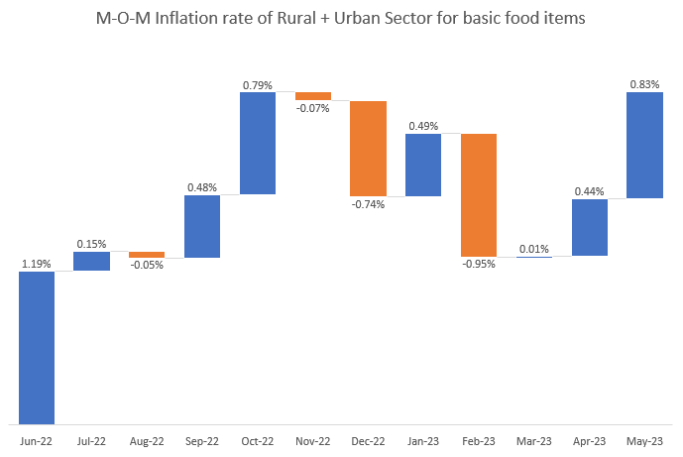
Food Inflation Overview: Rural + Urban Sector
Basic Food Items :
Year | May-22 | Jun-22 | Jul-22 | Aug-22 | Sep-22 | Oct-22 | Nov-22 | Dec-22 | Jan-23 | Feb-23 | Mar-23 | Apr-23 | May-23
Basic Food Items | 1596 | 1615 | 1618 | 1617 | 1625 | 1638 | 1637 | 1624 | 1632 | 1617 | 1617 | 1624 | 1638
 | Inflation M-O-M | 1.19% | 0.15% | -0.05% | 0.48% | 0.79% | -0.07% | -0.74% | 0.49% | -0.95% | 0.01% | 0.44% | 0.83%
Rural + Urban basic food inflation remained highly volatile throughout the analysis period.
Inflation reached its highest monthly increase of 1.19% in Jun 2022 before moderating and eventually declining to 0.95% in Feb 2023.
Following this decline inflation gradually recovered reaching 0.83% in May 2023.
Inflation Rebounded
Highest M-O-M Food Inflation.
Lowest M-O-M Food Inflation

Slide 16
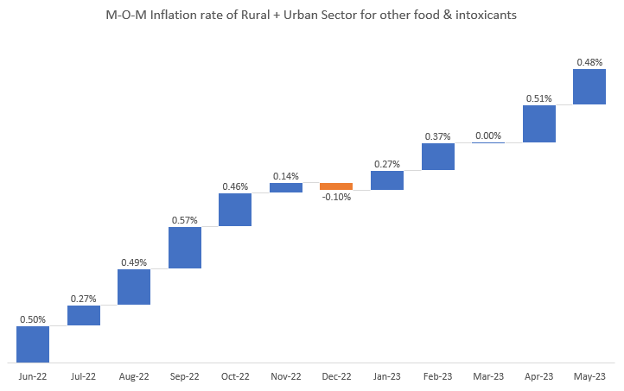
Food Inflation Overview: Rural + Urban Sector
Other Food & Intoxicants:
Year | May-22 | Jun-22 | Jul-22 | Aug-22 | Sep-22 | Oct-22 | Nov-22 | Dec-22 | Jan-23 | Feb-23 | Mar-23 | Apr-23 | May-23
Other Food and Intoxicants | 837 | 841 | 843 | 847 | 852 | 856 | 857 | 856 | 859 | 862 | 862 | 866 | 870
 | Inflation M-O-M | 0.50% | 0.27% | 0.49% | 0.57% | 0.46% | 0.14% | -0.10% | 0.27% | 0.37% | 0.00% | 0.51% | 0.48%
The inflation in this remained relatively stable throughout the analysis period. The category recorded its highest monthly inflation of 0.57% in Sep 2022 while the lowest inflation of -0.10% was observed in Dec 2022.
Following the brief decline inflation remained positive for 5 consecutive months from Jan 2023 to May 2023 ending at 0.48% in May 2023.
Highest M-O-M Food Inflation.
Inflation Showing a Positive Trend
Lowest M-O-M Food Inflation

Slide 17
Summary
Basic Food Items :
Sector | Highest Inflation | Lowest Inflation | Urban areas experienced the strongest inflation spike (1.31%), whereas rural areas experienced the sharpest decline(-1.12).
Rural | 1.09% | -1.12%
Urban | 1.31% | -1.04%
Rural + Urban | 1.19% | -0.95%
Other Food & Intoxicants:
Sector | Highest Inflation | Lowest Inflation | Urban areas recorded the highest spike (0.63%) while rural areas experienced the sharpest decline (-0.11%). Overall other food & intoxicants exhibited significantly lower volatility compared to basic food items across all sectors.
Rural | 0.52% | -0.11%
Urban | 0.63% | -0.10%
Rural + Urban | 0.57% | -0.10%

Slide 18
12-Month Food Inflation Trends Across Rural, Urban and Combined Sectors
Broader Category | Category | Rural | Urban | Rural + Urban
Basic Food Items | Cereals and products | 13.28% | 11.49% | 12.72%
 | Meat and fish | -1.49% | -0.81% | -1.24%
 | Egg | 5.95% | 7.68% | 6.65%
 | Milk and products | 9.11% | 8.46% | 8.85%
 | Oils and fats | -17.44% | -13.25% | -16.01%
 | Fruits | 0.60% | 0.74% | 0.70%
 | Vegetables | -7.29% | -8.96% | -7.95%
 | Pulses and products | 6.00% | 7.80% | 6.62%
 | Spices | 18.44% | 16.81% | 17.90%
Other Food & Intoxicants | Sugar and Confectionery | 2.52% | 2.48% | 2.51%
 | Non-alcoholic beverages | 3.18% | 4.67% | 3.77%
 | Prepared meals, snacks, sweets, etc. | 5.93% | 6.92% | 6.41%
 | Food and beverages | 3.51% | 3.15% | 3.35%
 | Pan, tobacco, and intoxicants | 3.63% | 3.39% | 3.55%
Note
Highest Inflation: Spices
Combined: 17.90%
Rural: 18.44%
Urban: 16.81%
Significant Inflation: Cereals and products
Combined: 12.72%
Rural: 13.28%
Urban: 11.49%
Largest deflation:
Oils & Fats: -16.01%
Vegetables: -7.95%

Slide 19
Impact of Covid-19 on Rural Inflation: A Before and After Comparison
Category | Before Covid(2017-2020) | After Covid(2020-2023) | Change
Food Products Combined | 1.75% | 3.29% | + 1.54
Fuel and light | -0.06% | 0.15% | + 0.21
Health | 3.07% | 1.78% | - 1.29
Transport and communication | 1.82% | 4.28% | + 2.46
Education | 2.81% | 0.28% | - 2.53
Household goods and services | 1.39% | 0.65% | - 0.74
General index | 1.29% | 1.83% | + 0.54
Largest Increase: Transport & Communication (2.46 points).
Largest Decline: Education (-2.53 points).
Food Inflation: Increased by 1.54 points
Overall rural inflation: Increased by 0.54 points.

Slide 20
Impact of Covid-19 on Urban Inflation: A Before and After Comparison
Category | Before Covid(2017-2020) | After Covid(2020-2023) | Change
Food Products Combined | 3.74% | 3.62% | - 0.12
Fuel and light | 1.00% | -0.13% | - 1.13
Health | 1.47% | 2.29% | + 0.82
Transport and communication | 1.35% | 5.72% | + 4.37
Education | 2.27% | -0.18% | - 2.45
Household goods and services | 1.21% | 1.43% | + 0.22
General index | 1.73% | 1.95% | + 0.22
Largest Increase: Transport & Communication (4.37 points).
Largest Decline: Education (-2.45 points).
Food Inflation: Decreased slightly by - 0.12 points
Fuel & Light: Decreased significantly by – 1.13 points
Overall urban inflation: Increased by 0.22 points.

Slide 21
Impact of Covid-19 on Rural + Urban Inflation: A Before and After Comparison
Category | Before Covid(2017-2020) | After Covid(2020-2023) | Change
Food Products Combined | 2.51% | 3.38% | + 0.87
Fuel and light | 0.29% | 0.00% | - 0.29
Health | 2.49% | 1.94% | - 0.55
Transport and communication | 1.59% | 5.01% | + 3.42
Education | 2.52% | 0.00% | - 2.52
Household goods and services | 1.29% | 1.03% | - 0.26
General index | 1.50% | 1.88% | + 0.38
Largest Increase: Transport & Communication (3.42 points).
Largest Decline: Education (-2.52 points).
Food Products Combined Inflation: increased by 0.87 points
Fuel & Light: Decreased slightly by – 0.29 points
Overall urban inflation: Increased by 0.38 points.

Slide 22
Imported Cude Oil Prices and Trends (2021-2023)
Month & Year | Import Value (Mn USD) | Import Quantity (Metric Tones) | Unit Price (USD/Tones) | MoM Change (%)
May-2021 | 8262 | 17259 | 0.479 | 2.16%
June-2021 | 8289 | 15905 | 0.521 | 8.86%
July-2021 | 7976 | 15021 | 0.531 | 1.88%
Note: Monthly unit prices were derived using import value divided by the import quality.
Key Insights
Highest Increase: 18.31% (Mar-22).
Highest Decline: -9.52% (Dec-22).
Peak volatility observed during 2022.
Prices remained mostly negative during late 2022 and early 2023.
Highest Crude Oil Inflation
Lowest Crude Oil Inflation

Slide 23
Correlation Analysis: Imported Crude Oil Prices vs CPI Inflation Categories (Rural + Urban)

